Slide 1
Principles of Christlike Teaching: Invite Diligent Learning
Help learners take responsibility for their learning.

Slide 2
Lesson Manual Location
churchofjesuschrist.org /
Library /
Books and Lessons /
Teaching and Learning /
Teacher Development Skills

Slide 3
Invite Diligent Learning
Help learners take responsibility for their learning.
Encourage learners to come to know the Savior by studying the gospel daily.
Invite learners to prepare to learn.
Encourage learners to share the truths they are learning.
Invite learners to live what they are learning.

Slide 4

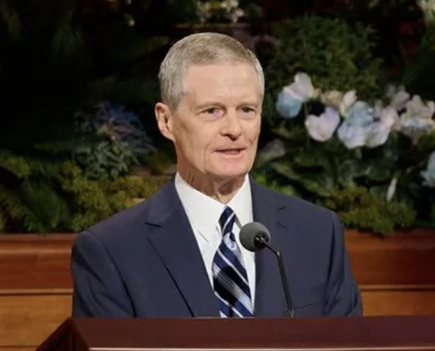
The Savior Helped Others Take Responsibility for Their Learning
Elder David A. Bednar counseled:
  “Our intent ought not to be ‘What do I tell them?’
  Instead, the questions to ask ourselves are
  What can I invite them to do?
  What inspired questions can I ask that, if they are willing to respond, will begin to invite the Holy Ghost into their lives?”

Slide 5
The Savior Helped Others Take Responsibility for Their Learning
Questions to Ponder
Why is it important for learners to be active rather than passive in their learning?
How can you help them take responsibility for their learning?
How have teachers helped you do this?
What examples from the scriptures can you think of where people were invited to learn for themselves?
How do these examples affect how you teach?

Slide 6
Help learners take responsibility for their learning.
Resist the tendency to respond to every comment and question and invite the class to respond.
Focus on what the learner can do in class that the teacher typically does.

Slide 7

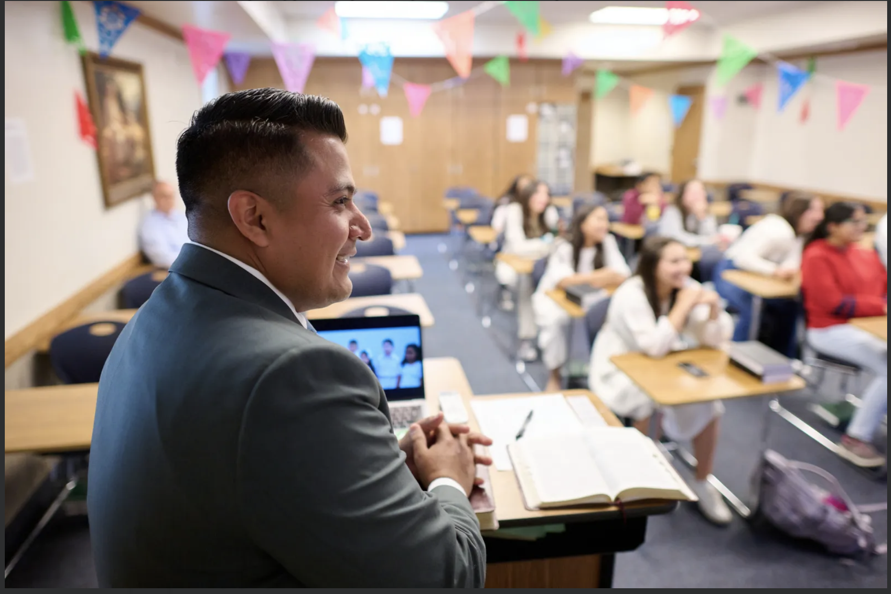
Resist the tendency to respond to every comment and question and invite the class to respond.

Slide 8
Resist the tendency to respond to every comment and question and invite the class to respond.
Skill
Teachers can invite diligent learning by establishing a pattern where students respond to each other in a classroom instead of or before the teacher.
When teachers allow students to share their thoughts on peer comments and questions, the focus stays fixed on the learners and discussions become more engaging with increased student participation.
Asking questions that allow students to share their thoughts and impressions on what others have said, instead of or before the teacher comments.

Slide 9
Resist the tendency to respond to every comment and question and invite the class to respond.
Model
Here are a few example questions you can ask to invite the class to share their thoughts about a student’s comment or question:
Who can share an experience related to what Gary just said?
What surprised or impressed you about Lucinda’s comment?
Who can testify of what Peter just said?
What could you share about what you’ve learned as you have pondered that question?

Slide 10
Resist the tendency to respond to every comment and question and invite the class to respond.
Practice
For each of the following scenarios, instead of commenting on the student’s question or comment, choose one of the model questions to ask the class or one of your own.
During class, Amy asks the following question: “How can I know if a thought is a prompting or if it is my own thoughts?”
During a lesson in the Old Testament, Kyle says, “I think it is pretty amazing to see that the Lord invites Israel to repent and come back to Him, despite how many times they’ve turned away from Him.”
Think of a comment or question from a student in a recent class. Using this skill, how could you respond?

Slide 11
Resist the tendency to respond to every comment and question and invite the class to respond.
Discuss or Ponder
Consider how you typically respond when a student makes a comment in class.
What positive outcomes might you experience as you help students respond to one another instead of or before making a comment?

Slide 12
Resist the tendency to respond to every comment and question and invite the class to respond.
Incorporate
As you prepare your next lesson, select a few of the model questions or ones you come up with on your own, to allow students to respond to one another.

Slide 13

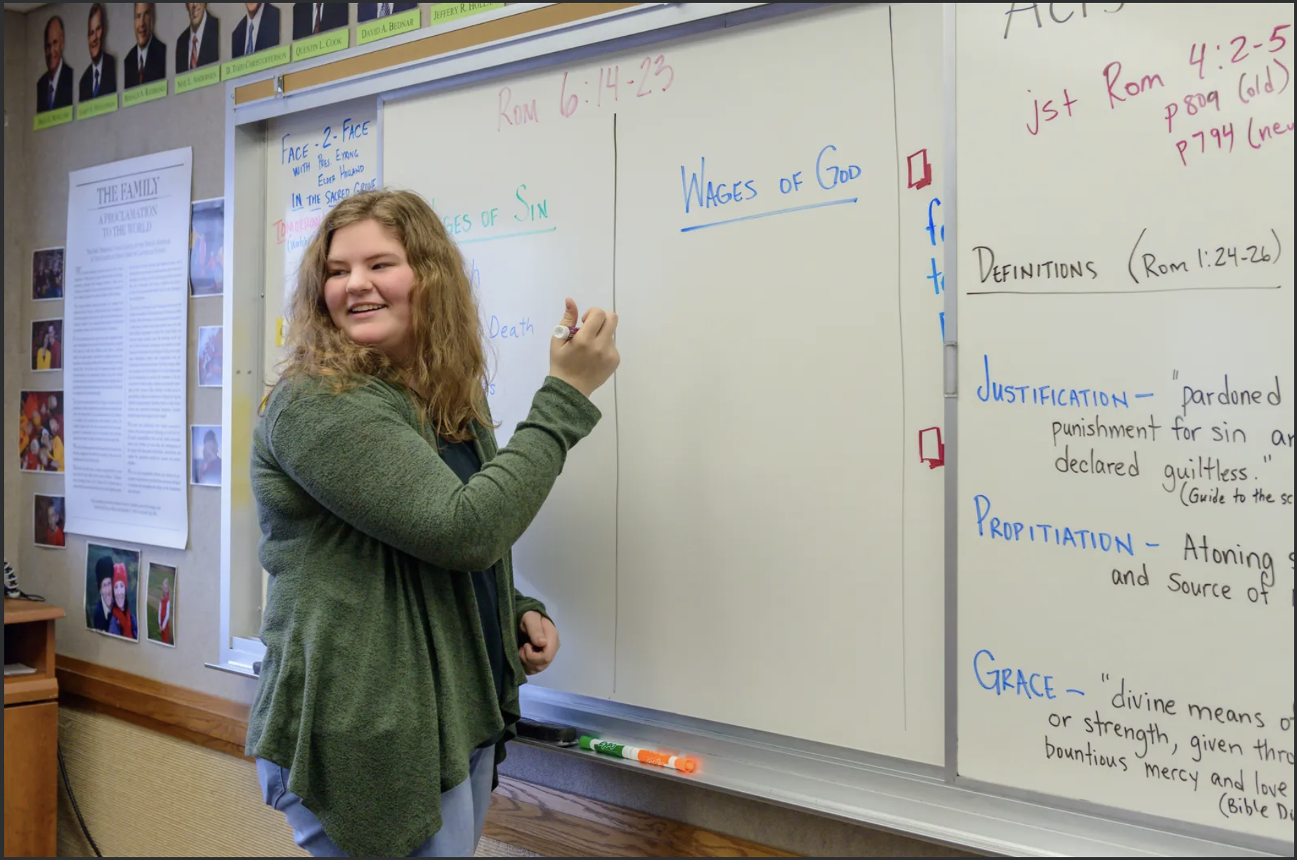
Focus on what the learner can do in class that the teacher typically does.

Slide 14
Focus on what the learner can do in class that the teacher typically does.
Skill
Students can take responsibility for their learning in class by doing things the teacher normally does. During lesson preparation, teachers can:
Look at a block of scripture they will be teaching in the future.
Consider the curriculum and some of the things they might normally do as they teach this block (for example: ask questions, lead a discussion, write on the board, share insights, and so on).
Ask, “What can I have students do in class that I normally do?”
Record impressions in the lesson plan and implement them during class.

Slide 15
Focus on what the learner can do in class that the teacher typically does.
Model
As she prepares her next lesson, Sister Lawas wants to invite students to engage in a discussion regarding the principles they have discovered. Before she creates the questions they will discuss, she asks herself, “What can I have students do in class that I normally do?” Sister Lawas decides she will have her students create the discussion questions in class this time and makes a note in her lesson plan.

Slide 16
Focus on what the learner can do in class that the teacher typically does.
Practice
What might you ask students to do in class that you are planning to do as the teacher in the following situations?
You plan to write student responses on the board as they answer a question about focusing on the Savior during the sacrament.
You plan to share a personal experience related to an upcoming principle.
Considering an upcoming lesson, what might you ask students to do in class that you are planning to do as the teacher?

Slide 17
Focus on what the learner can do in class that the teacher typically does.
Discuss or Ponder
After your practice experience, what value do you see in looking for ways to allow the students to do in class what you would normally do?
What are some other ways you feel this could be done in the classroom with students?

Slide 18
Focus on what the learner can do in class that the teacher typically does.
Incorporate
As you prepare your next lesson, take time to consider what you would normally do in class and then ask yourself the question, “What can I have students do that I normally do?” Record your impression and look for ways to incorporate them.
During lesson preparation, how can you create the habit of asking yourself the question “What can I have students do in class that I normally do?”

Slide 19
Summary
Help learners take responsibility for their learning.
Resist the tendency to respond to every comment and question and invite the class to respond.
Focus on what the learner can do in class that the teacher typically does.

